Slide 1
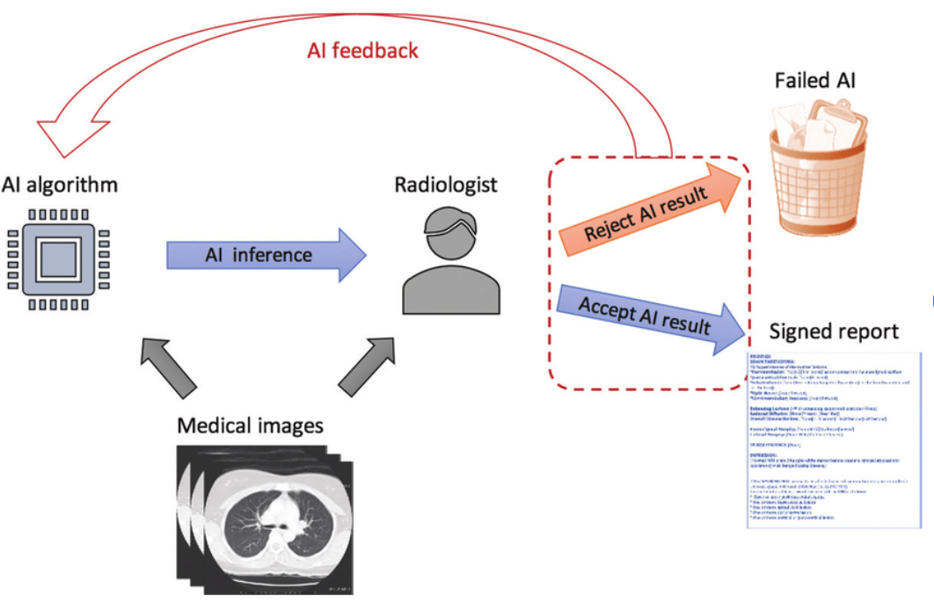
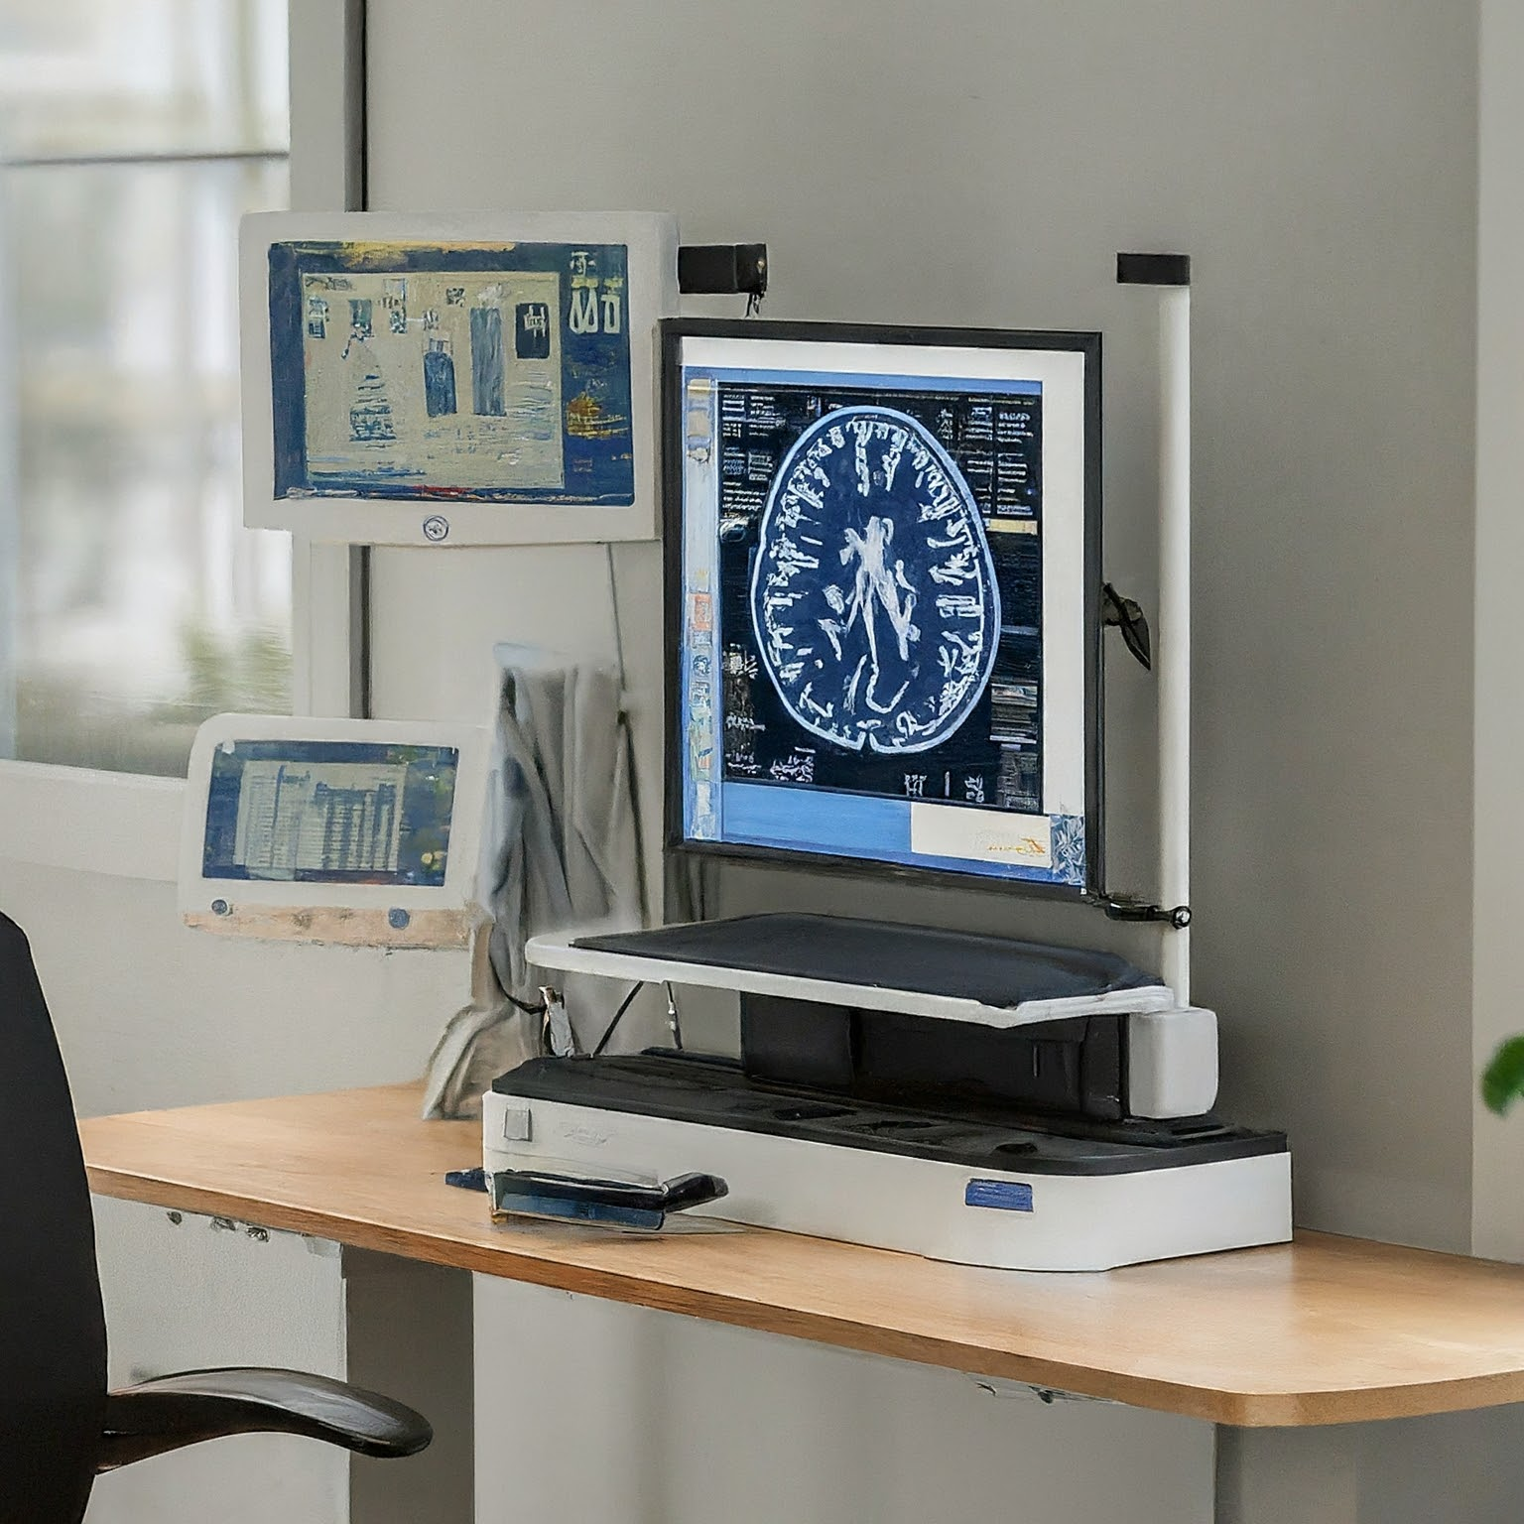
Smart Radiology AI IoT of Diagnostics: Connecting Radiologists with AI-driven Image Analysis

Slide 2
Problem Statement
The challenge faced by radiologists in accurately and efficiently diagnosing diseases from medical images such as X-rays, MRI scans, and CT scans due to the increasing volume and complexity of imaging data.
Limited Access to Specialized Expertise:
Not all healthcare facilities have access to highly specialized
radiologists,especially in remote or under-resourced areas.
Patients in these areas may receive lower-quality diagnostics, leading to disparities in healthcare outcomes based on geographic location.

Slide 3
Statistics
Global AI in Medical Imaging market size reached USD 4.3 Billion in 2023 and is expected to grow at a CAGR of 28.4% to reach USD 23.6 Billion by 2030.
Estimated at 20-30% of radiology departments in developed countries use AI-powered image analysis tools in 2023.
"AI in Healthcare: Balancing Cost and Innovation ,Artificial Intelligence in Healthcare Market to Reach $6.6 Billion by 2021“
click here for Source link
click here for source link

Slide 4
Stakeholders
Radiologists
Healthcare Providers
Patients
Medical Imaging Companies
Health Insurance Companies
Regulatory Bodies

Slide 5
Present Scenario
Radiologists are overwhelmed with increasing volumes of medical images to analyze daily.
Variability in diagnostic accuracy and consistency due to differences in experience and fatigue.
Limited access to specialized radiology expertise in underserved or remote healthcare facilities.
Complex medical imaging techniques require continuous learning and specialization.
Integration issues between imaging systems and electronic health records (EHRs) hinder efficiency
Regulatory and ethical concerns regarding AI use in clinical decision-making are still evolving

Slide 6
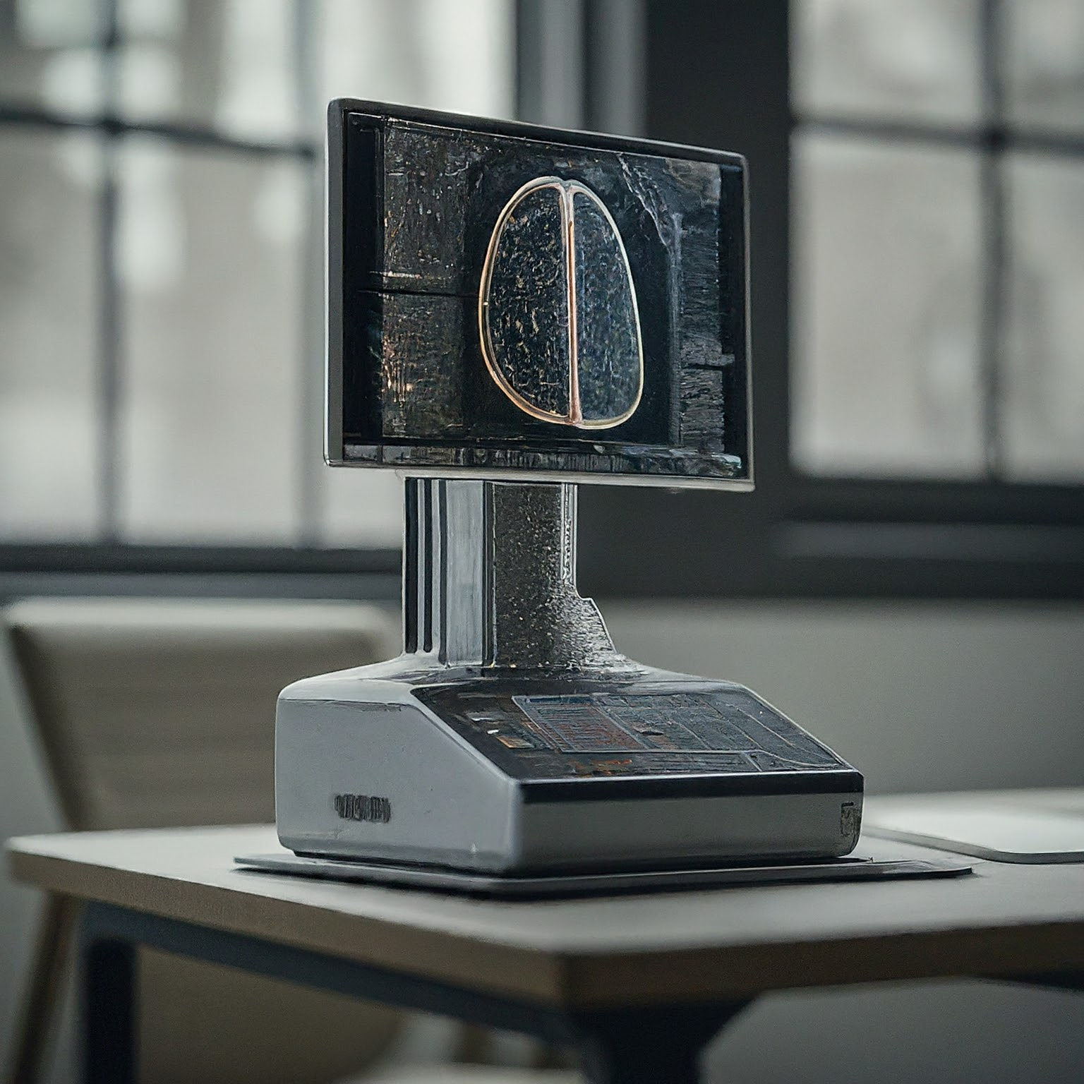
Proposed Solution- Predictive/Preventive Maintainance
Notifications coming from the System:
Alerts on image quality:
Alerts for System Health:
Additional Alerts: Notifications related
to data storage issues, processing delays,
or integration errors with EHR systems.
Scheduled Maintenance→Regular
updates and system checks to ensure the
AI algorithms and hardware are functioning optimally.

Slide 7
Features
Automated Image Analysis: AI-driven analysis of medical images (e.g., X-rays, MRIs, CT scans) to assist radiologists in identifying anomalies and making diagnoses faster.
Real-time Alerts: Immediate notifications for radiologists when potential abnormalities are detected in images, highlighting areas of concern.
Integration with EHRs: Seamless integration with Electronic Health Records (EHR) systems for easy access to patient history and sharing of diagnostic results.
Predictive Diagnostics: Use of machine learning models to predict disease progression or likelihood based on image data and patient history.

Slide 8
Predictive Diagnostics: Use of machine learning models to predict disease progression or likelihood based on image data and patient history.
Predictive Diagnostics: Use of machine learning models to predict disease progression or likelihood based on image data and patient history.
User-Friendly Interface: An intuitive interface that allows radiologists to easily navigate through images, adjust parameters, and access relevant patient data without technical complexity.
Data Security and Compliance: Built-in data encryption and compliance with healthcare regulations (e.g., HIPAA) to ensure patient data privacy and security.

Slide 9
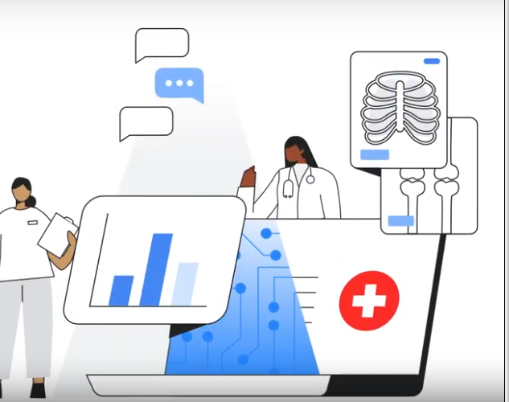
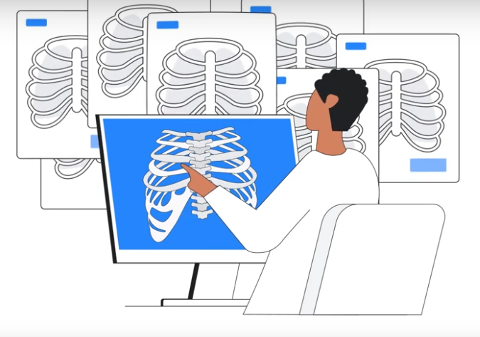
Steps to solve patients problem
By the Smart Radiology AI :
→Data Collection
→Preprocessing
→Analysis and Diagnosis
→Reporting
→Review by Radiologist
→Treatment Recommendation
→Patient Communication
→Continuous Learning

Slide 10
